Slide 1


Relational Modeling
in Dia
Your Instructor: Judy Richardson

Slide 2
For this Course:
Dia:
Diagramming Software
Loaded on your virtual desktop
Free for you to download on your own computer after this course

Slide 3
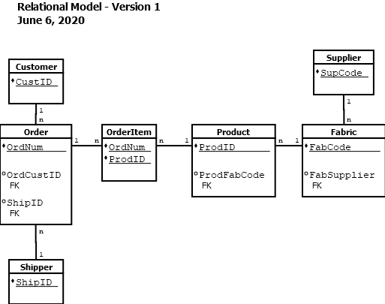
Example of a Relational Model:

Slide 4
Task 1: ERD Revisited
Relational Modeling with Dia

Slide 5
Steps in Database Design:
Requirements Analysis
Entity Relationship Diagram (ERD)
Relational Model

Slide 6
ERD -> Relational Model:
Convert the ERD into a Relational Model
The ERD has everything needed to draw a relational model diagram
Plus…a few modeling rules (coming soon…)

Slide 7
Task 2: Relational Model Components
Relational Modeling in Dia

Slide 8
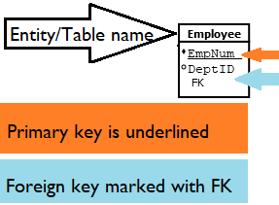
Entities become Tables

Slide 9
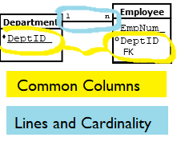
Relationships without diamonds

Slide 10
Task 3: Entities and Attributes
Relational Modeling in Dia

Slide 11
Task 4: One-to-Many Relationships
Relational Modeling in Dia

Slide 12
Relational Model:
Blueprint for creating the database using a DBMS (MySQL, Access, Oracle, etc.)

Slide 13
Relational Database Concept:
Tables are related via common columns
Every table has to be related to at least one other table

Slide 14
Relational Database Concept:
Two tables with a one-to-many relationship must have a common column
The column from at least one of the tables must be a primary key

Slide 15
Relational Database Concept:
If two tables with a one-to-many relationship do not have a common column
Add a foreign key to one table

Slide 16
Foreign Key:
A foreign key in one table points to a primary key in another table.
The foreign key always goes on the “many” side of a relationship.

Slide 17
Task 5: Many-to-Many Relationships
Relational Modeling in Dia

Slide 18

Many-to-Many Relationship
When two tables with a n:n relationship have no common columns, adding a foreign key will not help.

Slide 19
Many-to-Many Relationship
Add ProdID foreign key to Order table?
Each order could have only one product. NOT GOOD!

Slide 20
Many-to-Many Relationship
Add OrdNum foreign key to Product table?
Each product could have only be on one order. NOT GOOD!

Slide 21
Bridge Table:
The table used to show a many-to-many relationship is called a Bridge Table
Sometimes called an Intersection Table

Slide 22
Bridge Table:
The bridge table contains the primary keys from the tables with the n:n relationship.
They are primary keys in the bridge table as well.

Slide 23
Bridge Table:
The bridge table is always the “many” side when adding connectors.

Slide 24
Task 6: The Complete Relational Model
Relational Modeling in Dia

Slide 25
One-to-Many Rule:
When tables with a 1:n relationship have no common columns
Add a foreign key to the table on the “many” side
The foreign key must match the primary key from the table on the “one” side.

Slide 26

Congratulations on completing
Relational Modeling
in Dia

